Slide 1


Domain Adaptation approaches for end2end ASR models
Presented by: Kwok Chin Yuen
Supervisor: A/P Chng Eng Siong

Slide 2
About Me
Name: Kwok Chin Yuen
Status: Third Year Ph.D. candidate
Matriculated date: 10-Aug-2021
Year 1 & 2 TAC appraisal passed
Supervisor: Prof. Chng Eng Siong
CGPA: 4.83
Publications:
ASR Model Adaptation for Rare Words Using Synthetic Data Generated by Multiple Text-To-Speech Systems
Notes:
Thi

Slide 3
Outline
Introduction
What is ASR
What is end-to-end?
What is domain adaptation?
What are the side effects/constraints of ASR adaptation?
Research Motivation
Contributions
TTS data adaptation using multiple TTS
Analyse the different output distributions from different TTS
Layerwise adaptation with automatic layer selection
Explore different strategies to freeze/early stop during training
Conclusion and Future Work

Slide 4

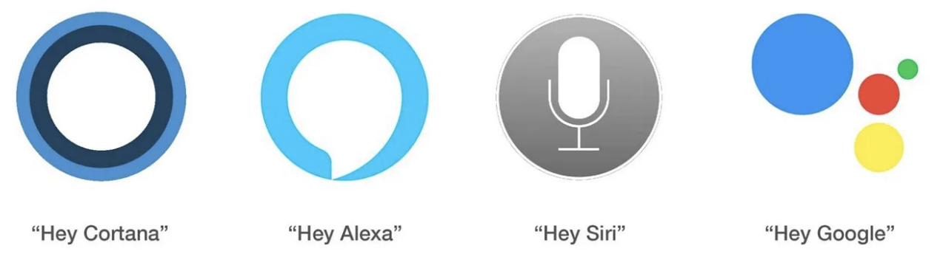
What is Automatic Speech Recognition (ASR)?
Title: Domain Adaptation approaches for end2end ASR model
[1] Lv, Xiaoling, Minglu Zhang, and Hui Li. "Robot control based on voice command." 2008 IEEE International Conference on Automation and Logistics. IEEE, 2008.
[2] Aron, Jacob. "How innovative is Apple's new voice assistant, Siri?." (2011): 24.

Slide 5
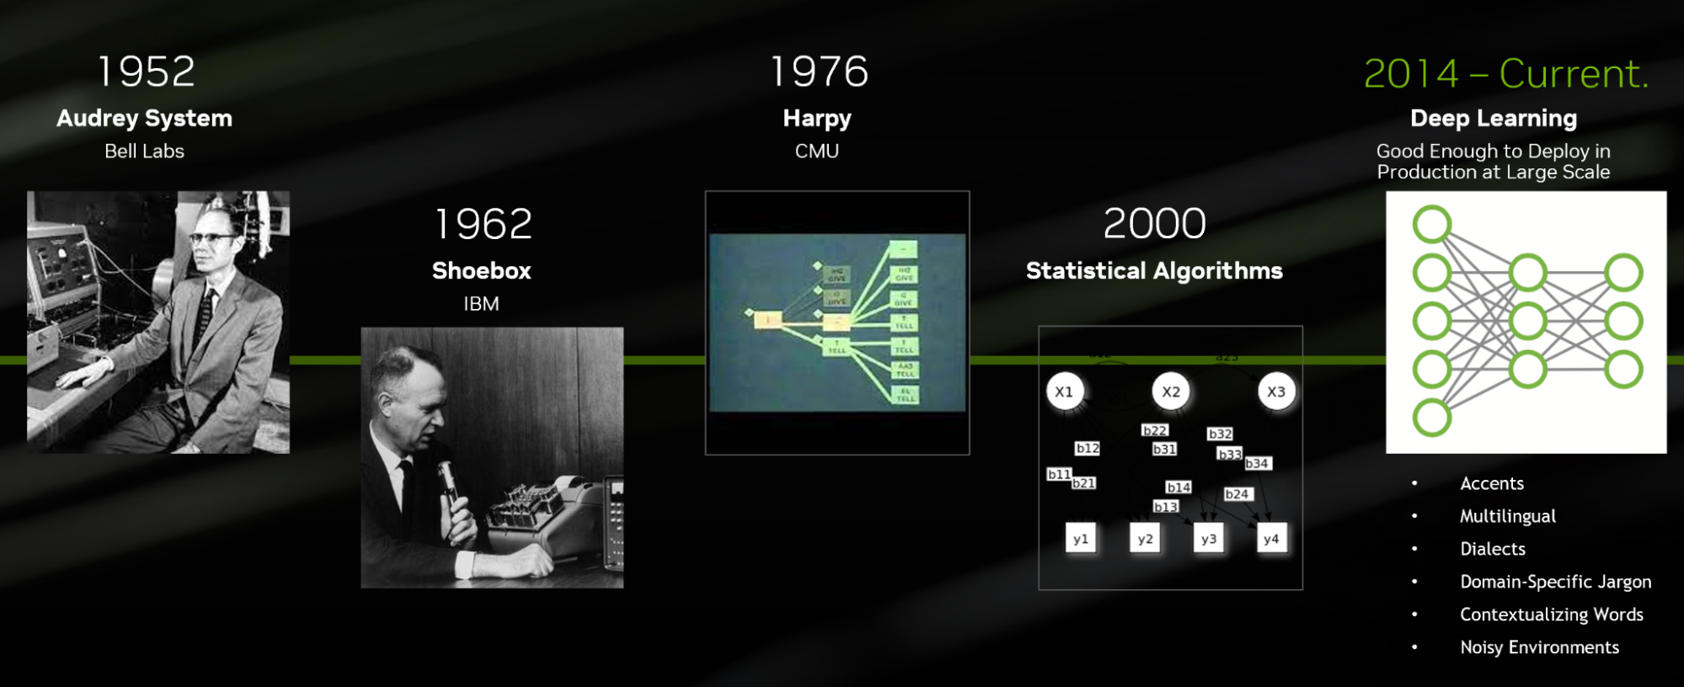
From statistical to end-to-end ASR models
Development of ASR systems:

Slide 6
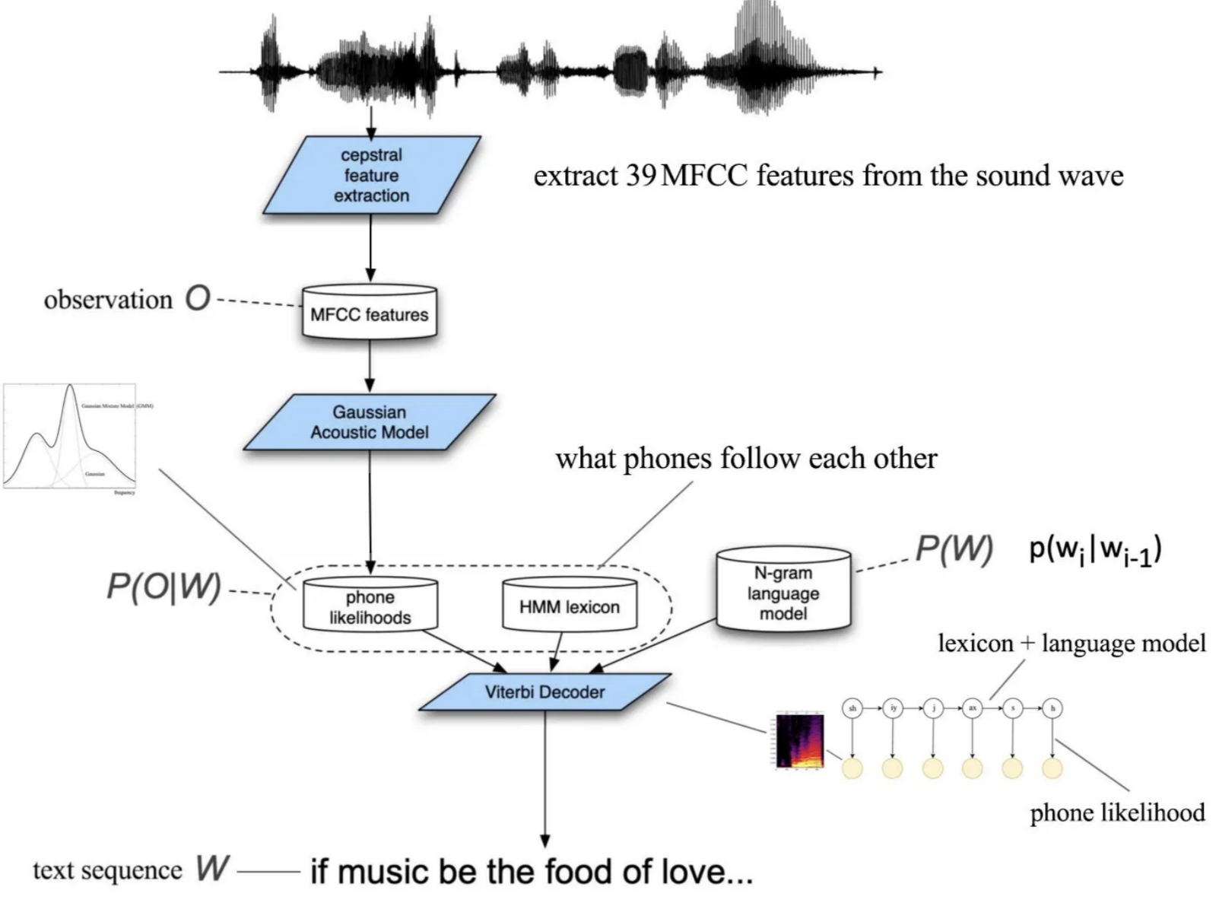
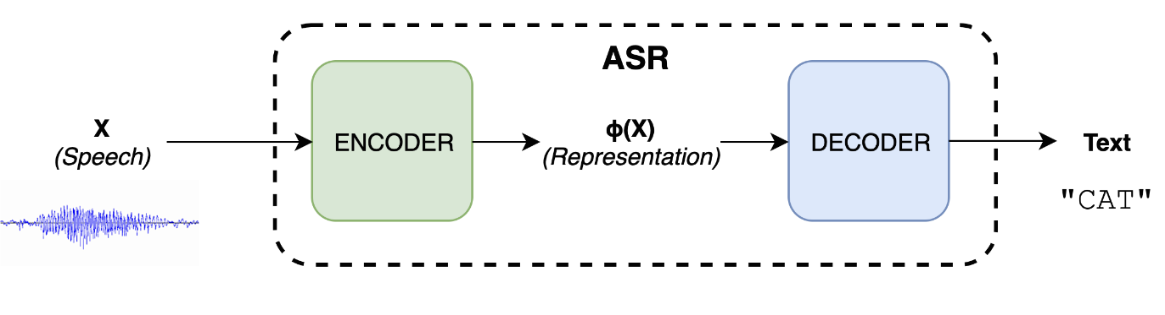
What is end-to-end?
Title: Domain Adaptation approaches for end2end ASR model
[1] William Chan, Navdeep Jaitly, Quoc V Le, and Oriol Vinyals. Listen, attend and spell. arXiv preprint arXiv:1508.01211, 2015
[2] Ashish Vaswani, Noam Shazeer, Niki Parmar, Jakob Uszkoreit, Llion Jones, Aidan N Gomez, Lukasz Kaiser, and Illia Polosukhin. Attention is all you need. Advances in neural information processing systems, 30, 201

Slide 7
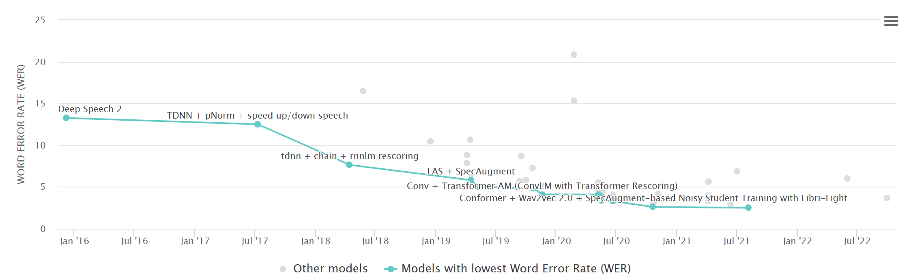
Recent progress in ASR
ASR is an active research field

Slide 8

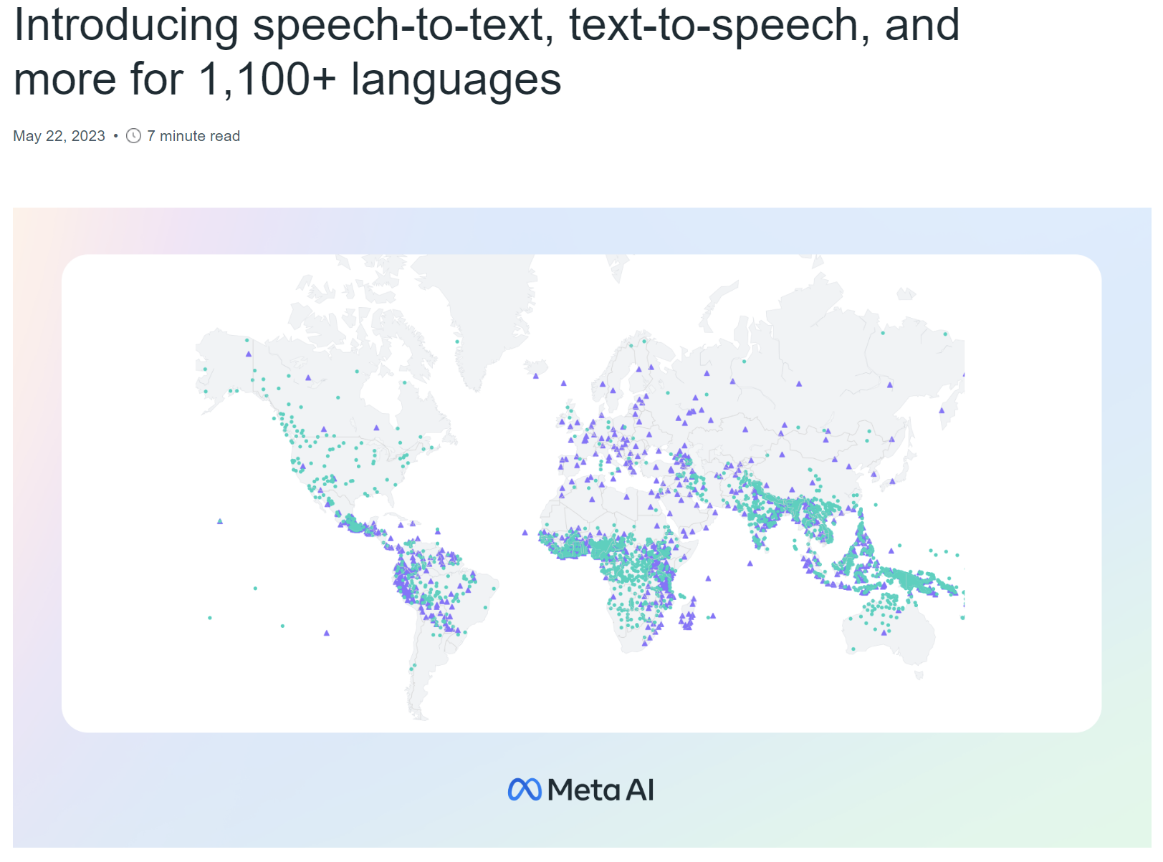
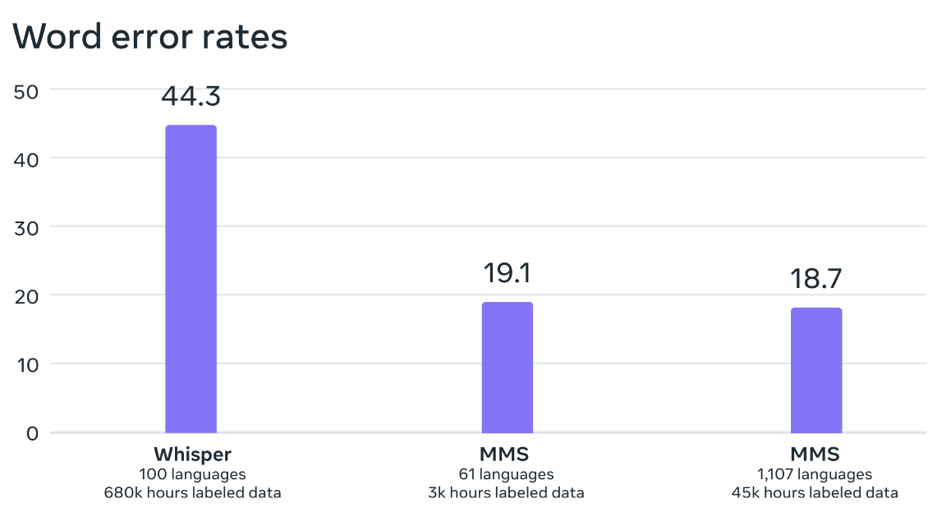
Recent progress in ASR: Massively large ASR model
OpenAI has released Whisper [1]
Multilingual ASR (1000+ languages)
Released in 2022
MetaAI has released MMS [2]
Released in 2023
Multilingual ASR (1000+ languages)
[1] Radford, Alec, et al. "Robust speech recognition via large-scale weak supervision." International Conference on Machine Learning. PMLR, 2023.
[2] Pratap, Vineel, et al. "Scaling speech technology to 1,000+ languages." arXiv preprint arXiv:2305.13516 (2023).

Slide 9
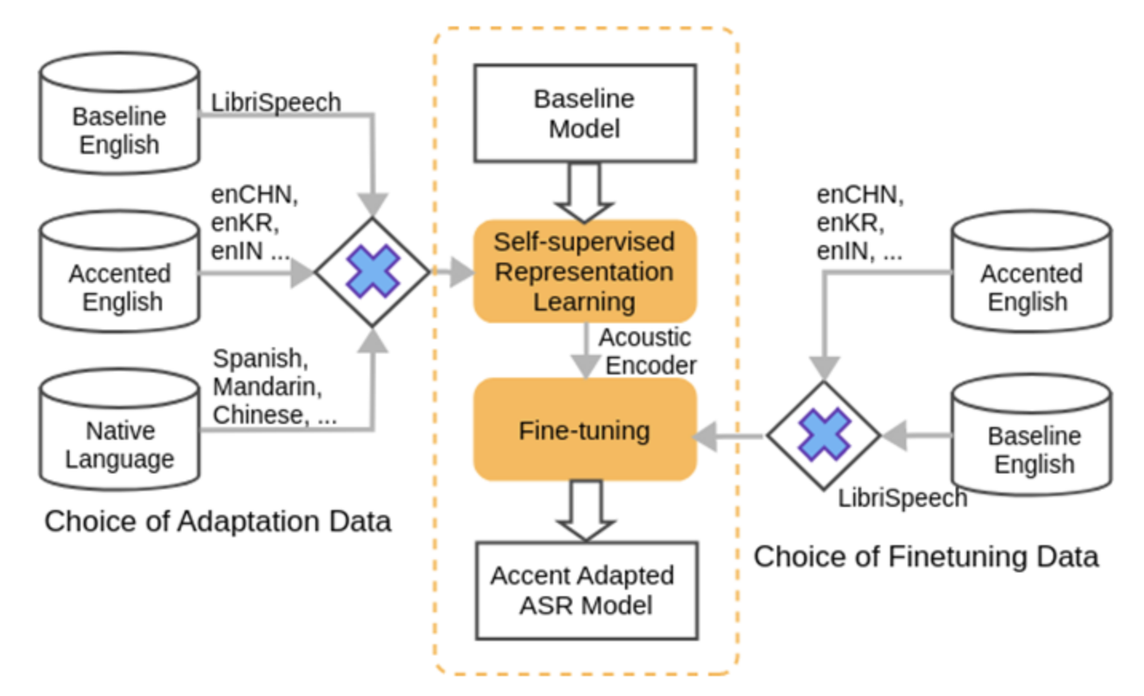
What is domain adaptation?
Title: Domain Adaptation approaches for end2end ASR model
Lack of generalization [1]
Solution: ASR adaptation [2,3]
Bias ASR system to a specific domain
Model adaptation <- we focus on this
Feature adaptation
[1] Vassil Panayotov, Guoguo Chen, Daniel Povey, and Sanjeev Khudanpur Librispeech: an asr corpus based on public domain audio books. In 2015 IEEE international conference on acoustics, speech and signal processing (ICASSP), pages 5206–5210. IEEE, 2015.
[2] Katrin Tomanek, Vicky Zayats, Dirk Padfield, Kara Vaillancourt, and Fadi Biadsy. Residual adapters for parameter-efficient asr adaptation to atypical and accented speech. arXiv preprint arXiv:2109.06952, 2021
[3] Yuang Li, Yu Wu, Jinyu Li, and Shujie Liu. Prompting large language models for zero-shot domain adaptation in speech recognition. arXiv preprint arXiv:2306.16007, 202

Slide 10
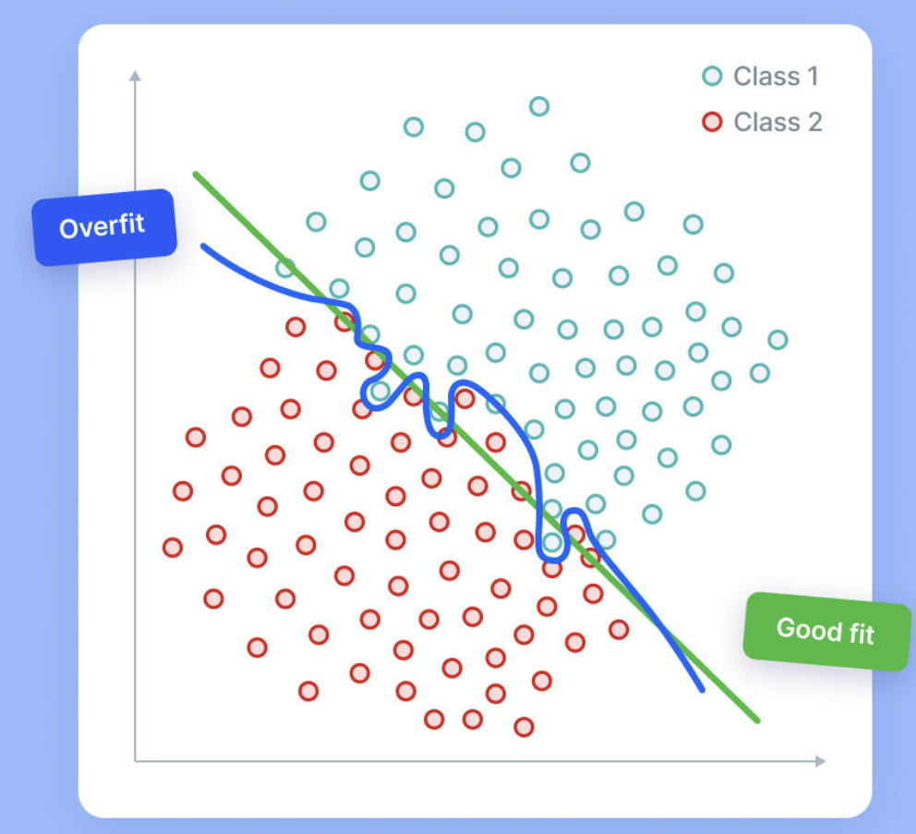
What are the side effects of ASR adaptation?
Overfitting [1]
Model perform well in train set but worse in test set
Catastrophic forgetting [2]
Adapted model has degraded performance on old domain
[1] Daniel Bashir, George D Monta ̃nez, Sonia Sehra, Pedro Sandoval Segura, and Julius Lauw. An information-theoretic perspective on overfitting and underfitting. In AI 2020: Advances in Artificial Intelligence: 33rd Aus- tralasian Joint Conference, AI 2020, Canberra, ACT, Australia, November 29–30, 2020, Proceedings 33, pages 347–358. Springer, 2020
[2] Cuong V Nguyen, Alessandro Achille, Michael Lam, Tal Hassner, Vijay Ma- hadevan, and Stefano Soatto. Toward understanding catastrophic forgetting in continual learning. arXiv preprint arXiv:1908.01091, 2019

Slide 11
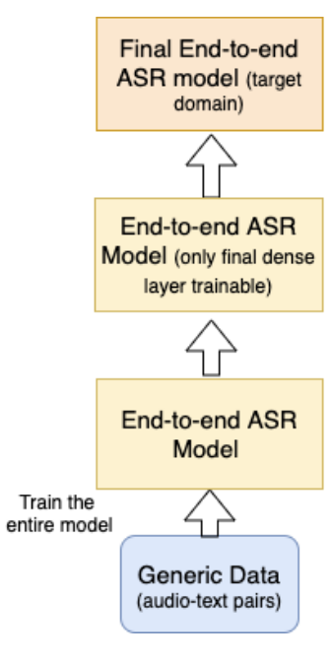
What are some constraints for ASR adaptation?
Text-only data training constraint
Supervised learning of ASR model requires audio-text data
What if only text is available?
We will discuss how to solve these problems:
Layerwise Adaptation
-> solve overfitting, catastrophic forgetting
TTS Synthesized Data Adaptation
-> solve text-only data training constraint
[1] Joshi, Raviraj, and Anupam Singh. "A simple baseline for domain adaptation in end to end asr systems using synthetic data." arXiv preprint arXiv:2206.13240 (2022).

Slide 12
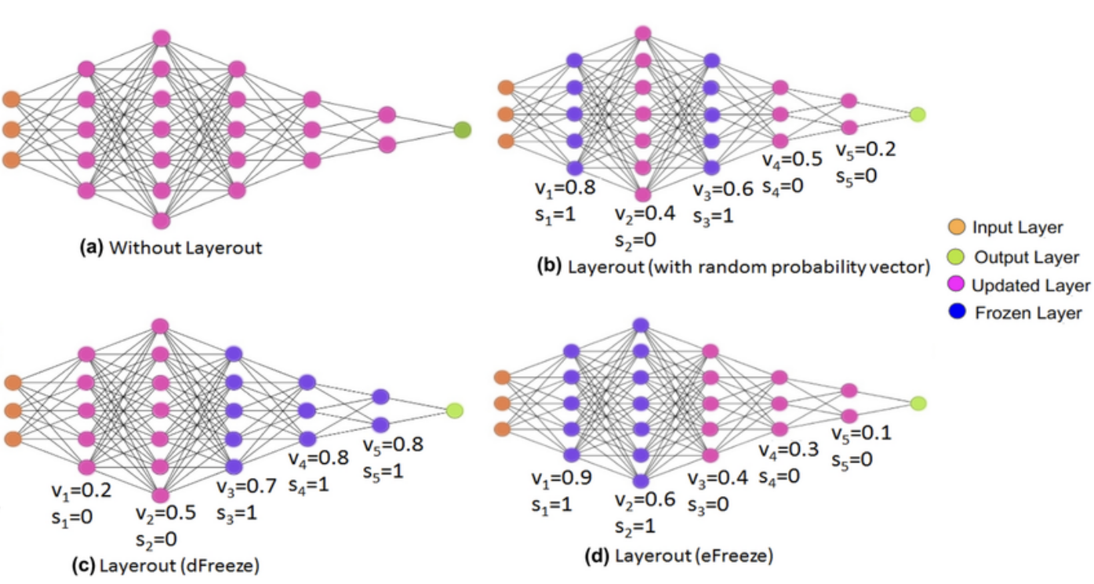
Why do we need Layerwise Adaptation?
Some weights may be more prone to overfitting or catastrophic forgetting
Different model weights contribute to different tasks more [1,2]
Update important weights only
[1] Zied Elloumi, Laurent Besacier, Olivier Galibert, and Benjamin Lecou- teux. Analyzing learned representations of a deep asr performance prediction model. arXiv preprint arXiv:1808.08573, 2018.
[2] Kyuhong Shim, Jungwook Choi, and Wonyong Sung. Understanding the role of self attention for efficient speech recognition. In International Conference on Learning Representations, 2021
[3] Goutam, Kelam, et al. "Layerout: Freezing layers in deep neural networks." SN Computer Science 1.5 (2020): 295.

Slide 13

What is the problem of Layerwise adaptation
How to choose which weight to freeze?
Previous works:
Freeze first few layers [1]
Freeze last few layers [2]
Choose set of layers require:
Heuristics -> requires expert knowledge
Trail-and-error -> expensive
We explore if there are an automatic way to choose the layers to freeze
[1] Prashanth Gurunath Shivakumar and Panayiotis Georgiou. Transfer learn- ing from adult to children for speech recognition: Evaluation, analysis and recommendations. Computer speech & language, 63:101077, 2020
[2] Xinwei Li, Yue Pan, Matthew Gibson, and Puming Zhan. Dnn online adapta- tion for automatic speech recognition. In Konferenz Elektronische Sprachsig- nalverarbeitung, pages 46–53. TUDpress, Dresden, 2018

Slide 14
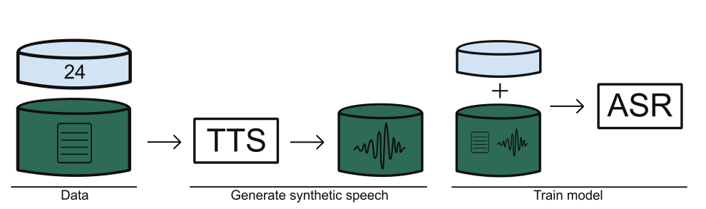

Why do we need TTS Synthesized Data Adaptation?
Supervised learning of ASR model require audio-text pair
What if we have text only?
Solution:
Synthesize fake audio with TTS system
The fake-audio real-text pairs can be used for ASR training

Slide 15
What is the problem of TTS Synthesized Data Adaptation?
Training ASR model with fake audio results in suboptimal performance
Fake audio does not follow the real distribution (artifacts, unnataural)
Increase the fake audio diversity -> more robust ASR
Aligns with studies from speed perturbation [1] and SpecAugment [2]
Augment audio to create more variations for robustness
Previous works explore to increase fake audio diversity by using a single TTS with tunable parameters to control speaker characteristic
However, increasing diversity with multiple TTS systems are rarely explored
We explore using multiple TTS for data generation
[1] Ko, Tom, et al. "Audio augmentation for speech recognition." Sixteenth annual conference of the international speech communication association. 2015.
[2] Park, Daniel S., et al. "Specaugment: A simple data augmentation method for automatic speech recognition." arXiv preprint arXiv:1904.08779 (2019).

Slide 16
Contribution
Layerwise adaptation
To the best of our knowledge, we propose the first automatic method that can effectively find the optimal set of layers to freeze
Our method outperforms heuristic based selection strategy by relative 6.2% word error rate
Our method also outperforms adapter-based adaptation and full finetuning
TTS synthesized data adaptation
We explore using multiple TTS systems for TTS data synthesis
Our method can improve transcription accruacy by relative 9.8% lower WER compared to using single TTS system synthesized data

Slide 17
Baseline End-to-end Transformer ASR adaptation Corpus: LibriSpeech 100h
English dataset
Clean read speech
Collected from LibriVox’s audio books
License: CC BY 4.0
Subset used:
Train-clean-100: 100h
Dev: 5h
Test-clean: 5h
Test-other: 5h
Corpus | Duration | Type | Language
LibriSpeech 100h | 100h | Clean read | English

Slide 18
Baseline End-to-end Transformer ASR adaptation Corpus: AISHELL-1
Mandarin dataset
400 speakers
Duration: 170H
Domain: Finance, science, etc.
License: Apache 2.0
Subset used:
Training: 150h
Development: 10h
Test: 5h
Corpus | Duration | Type | Language
LibriSpeech 100h | 100h | Clean read | English
AISHELL-1 | 170h | Clearn read | Chinese

Slide 19
Baseline End-to-end Transformer ASR adaptation Corpus: Datatang-ZH
Mandarin dataset
In-house telephony mandarin spontaneous dataset
Duration: 7h (test set only)
License: Proprietary
Subset used:
Test: 7h
Corpus | Duration | Type | Language
LibriSpeech 100h | 100h | Clean read | English
AISHELL-1 | 170h | Clearn read | Chinese
Datatang-ZH | 7h (test only) | Noisy Spontaneous | Chinese

Slide 20
Baseline End-to-end Transformer ASR adaptation Corpus: IMDA2
English dataset
Spontaneous
13K sentences with many road names inside
Collected from National Speech Corpus SG
Duration: 10h
Subset used:
Train: 10h
Test: 1.63h
Corpus | Duration | Type | Language
LibriSpeech 100h | 100h | Clean read | English
AISHELL-1 | 170h | Clearn read | Chinese
Datatang-ZH | 7h (test only) | Noisy Spontaneous | Chinese
IMDA2 | 10h | Spontaneous | English

Slide 21
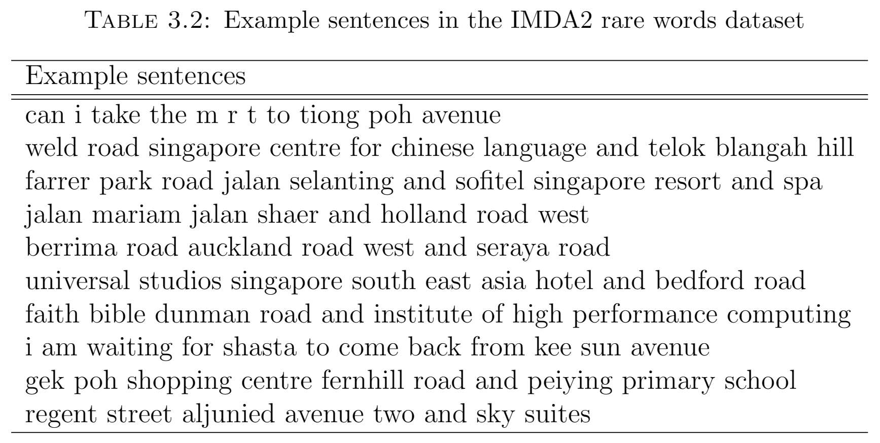
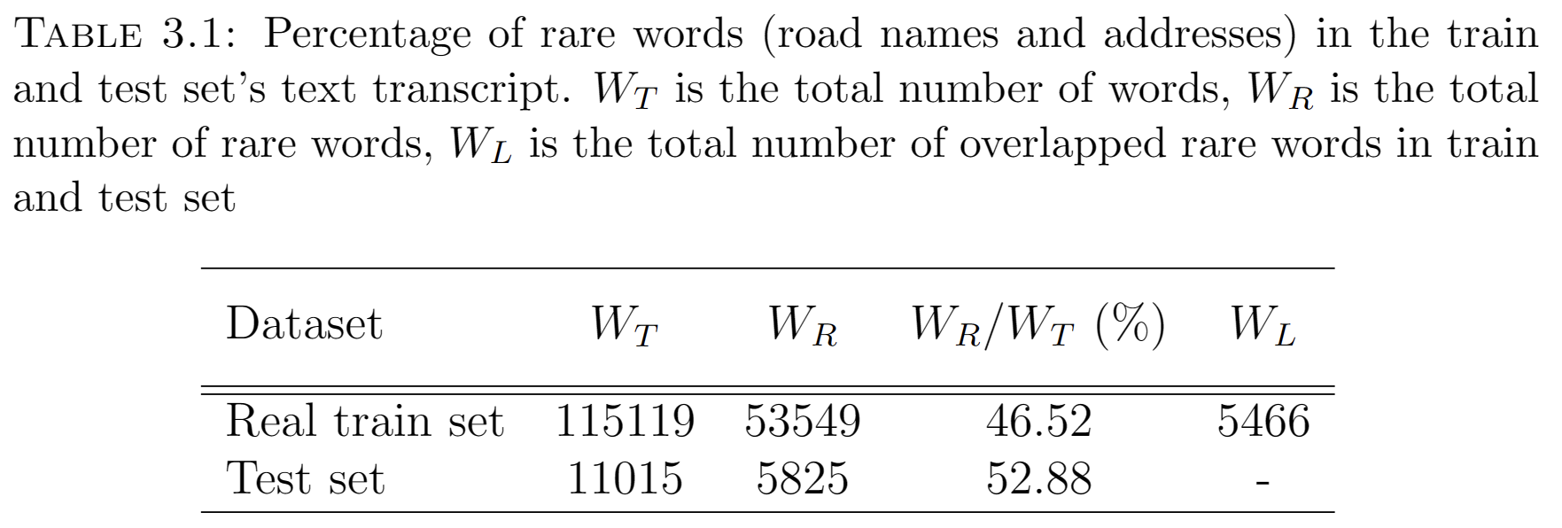
Baseline End-to-end Transformer ASR adaptation Corpus: IMDA2

Slide 22
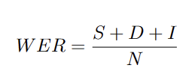
Baseline End-to-end Transformer ASR adaptation Evaluation metric: WER
Word error rate (WER)
Quantifies differences between hypothesis and reference transcript
Lower the better
WER equation:
S = Substitution count.
D = Deletion count.
I = Insertion count.
N = total number of words in transcript

Slide 23
ASR Model Adaptation for Rare Words Using Synthetic Data Generated by Multiple Text-To-Speech Systems A. Background:
Rare/OOV words are often associated with named entities like names and locations
Transcribing rare/OOV words correctly is crucial for ASR
However, rare/OOV words ASR task is challenging
ASR dataset for rare/OOV words is little -> Hard to train model
Hard to collect audio-text pairs data for rare/OOV words
Collect text-only dataset is easier
Assume we have abundant text-only data, how to train model?
Use TTS to synthesize fake audio from text-only data
The fake-audio real-text pairs can be used for ASR training

Slide 24
ASR Model Adaptation for Rare Words Using Synthetic Data Generated by Multiple Text-To-Speech Systems B. Motivation
Training ASR model with fake audio results in suboptimal performance
Fake audio does not follow the real distribution (artifacts, unnataural)
Increase the fake audio diversity -> more robust ASR
Aligns with studies from speed perturbation and SpecAugment
Augment audio to create more variations for robustness
Previous works explore to increase fake audio diversity by using multi-speaker TTS with tunable parameters to control speaker characteristic
However, increasing diversity with multiple TTS systems are rarely explored

Slide 25
ASR Model Adaptation for Rare Words Using Synthetic Data Generated by Multiple Text-To-Speech Systems C. Contribution
Explore using multiple TTS systems to increase fake audio diversity
Compare the effect of:
Multiple TTS systems conditioned on the same speaker
A single TTS system conditioned on multiple speakers.
Explore how layer-wise freezing improves ASR adaptation on fake audio data
Analyse the speaker embeddings of between different TTS systems

Slide 26
ASR Model Adaptation for Rare Words Using Synthetic Data Generated by Multiple Text-To-Speech Systems D. Methodology
Two TTS systems used:
TransformerTTS
Text-to-Spec: TransformerTTS
Vocoder: HiFi-GAN
VITS
Posterior encoder (Does not need for inference)
Prior encoder
Stocastic Duration Predictor
Decoder
Discriminator (Does not need for inference)

Slide 27
D. Methodology
Speaker map
Given a list of sentences from the text-only data
For each sentence, assign it a speaker (randomly sampled)
We get a speaker map with each sentence map to one speaker
We repeat the above process to get 2 speaker maps.
We refer the maps as SPKMAP1 and SPKMAP2
Produce 4 datasets from the 2 TTS systems and 2 speaker maps
Speaker Map \ TTS | VITS | TransformerTTS
SPKMAP1 | VITS-SPKSET1 | TRANS-SPKSET1
SPKMAP2 | VITS-SPKSET2 | TRANS-SPKSET2

Slide 28
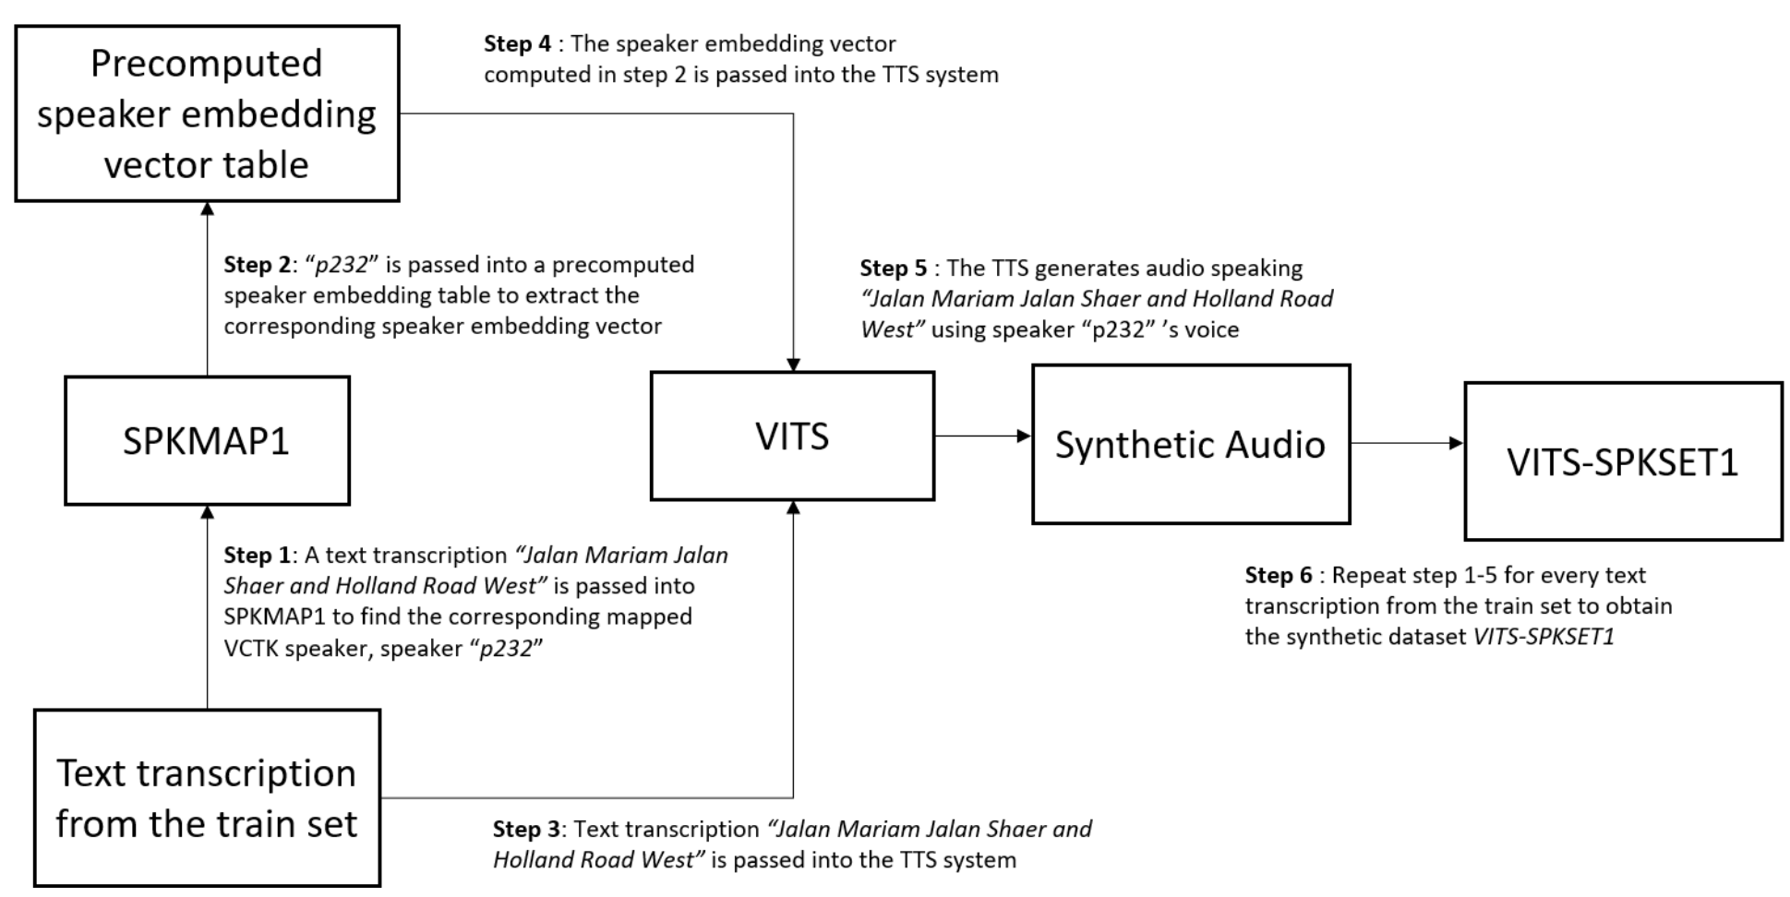
D. Methodology

Slide 29
E. Experiment 1
Compare the effect of:
Multiple TTS systems conditioned on the same speaker (multi-TTS-same-SPK)
A single TTS system conditioned on multiple speakers (same-TTS-multi-SPK)
multi-TTS-same-SPK Datasets:
VITS-SPKSET1 + TRANS-SPKSET1
same-TTS-multi-SPK Datasets :
VITS-SPKSET1 + VITS-SPKSET2
TRANS-SPKSET1 + TRANS-SPKSET2
Speaker Map \ TTS | VITS | TransformerTTS
SPKMAP1 | VITS-SPKSET1 | TRANS-SPKSET1
SPKMAP2 | VITS-SPKSET2 | TRANS-SPKSET2

Slide 30
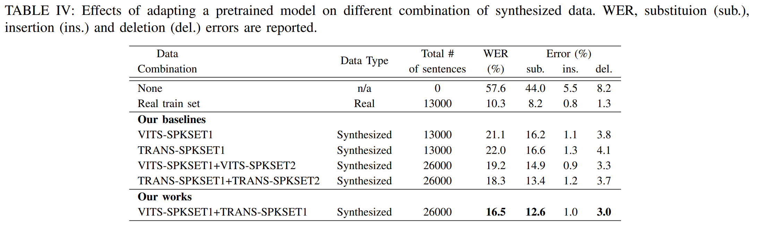
E. Experiment 1
TABLE IV shows that:
multi-TTS-same-SPK give lower WER than same-TTS-multi-SPK
This suggests that using multiple TTS to improve data diversity is better than using a single TTS conditioned on multiple speakers
VITS give lower WER than TransformerTTS

Slide 31
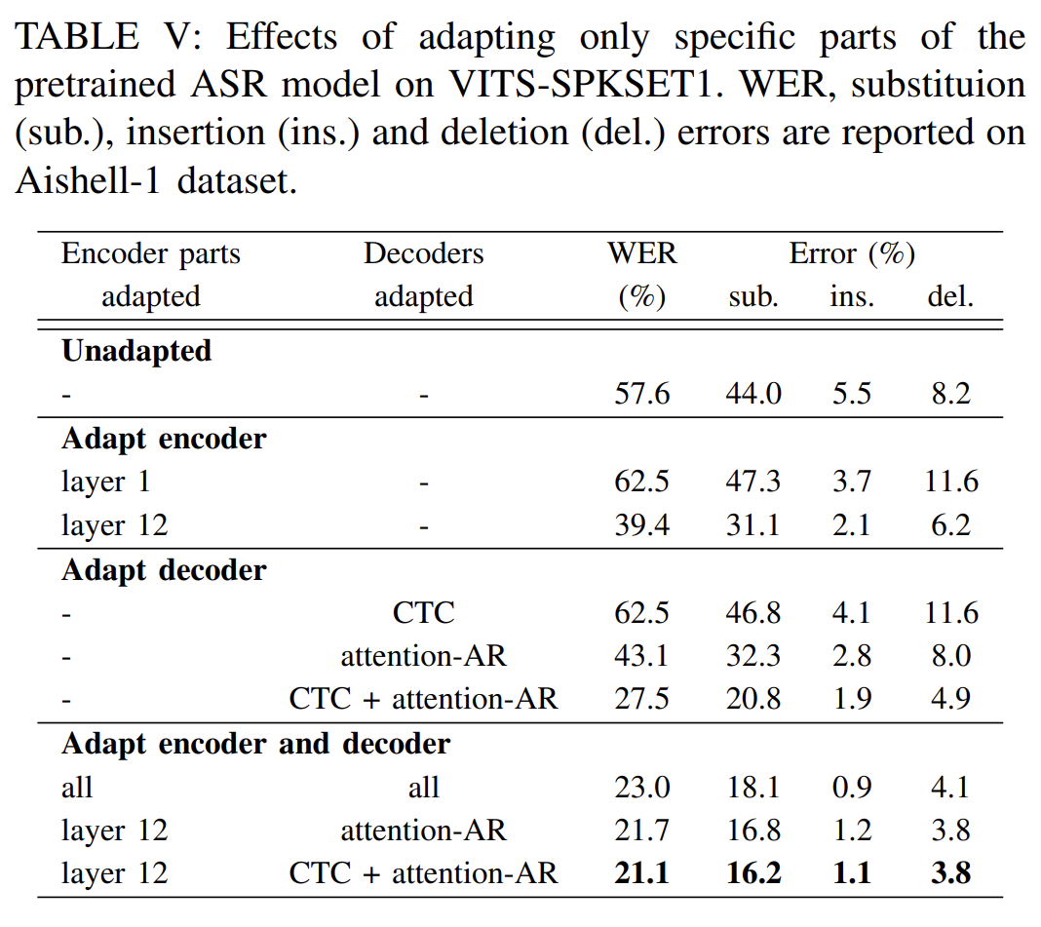
E. Experiment 2
Explore how layer-wise freezing improves ASR adaptation on fake audio data

Slide 32
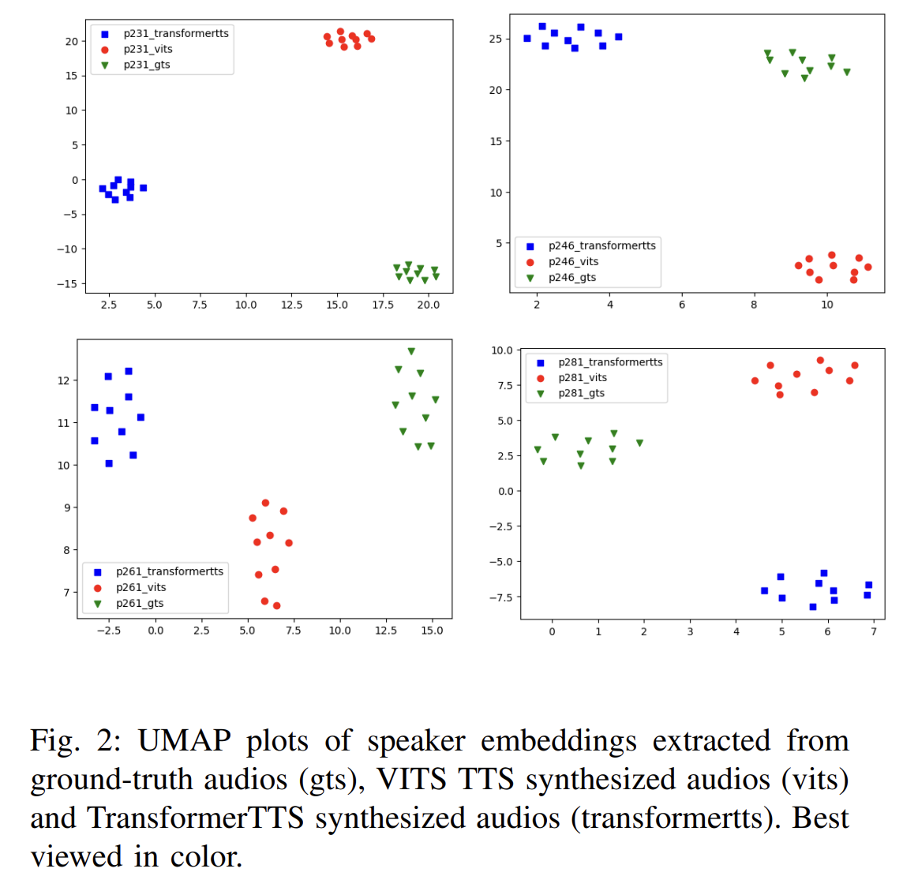
G. Analysis 1
Analyse the speaker embeddings (SPK EMB) between different TTS systems
Gaps exists between ground-truth SPK EMB and TTS SPK EMB for the same SPK
Different TTS give different SPK EMD for the same SPK
This suggests that using multiple TTS can improve data diversity

Slide 33
H. Analysis 2
Why the multi-TTS-same-SPK is better than same-TTS-multi-SPK?
TTS synthesized data may contain artifacts
It does not follow the real data distribution
By adapting the ASR model to multiple TTS output distributions
It is less likely for the ASR model to over-fit to a specific TTS output distribution
Therefore, it retains the ASR model’s capacity on processing real data

Slide 34
Layerwise Adaptation by using per-layer loss for automatic layer selection
A. Background
ASR adaptation is challenging due to overfitting and catastrophic forgetting
One approach to mitigate the issues is layerwise adaptation
Only adapt needed layers
Layers prone to overfitting/catastrophic forgetting are unmodified
How to find the optimal set layers to adapt?
Previous works relies on heuristics and trail-and-error
Require expert knowledge
Computationally expensive

Slide 35
Layerwise Adaptation by using per-layer loss for automatic layer selection
Introduction
We explore an automatic way to choose the set of layers to adapt
Our method applies to residual networks
Insight
Gradients computed from the loss function
->Directly back-propagated to the skip connections
Estimate the change of layer performance from each layer’s skip connection
We care if the performance degrades in
Source domain -> catastrophic forgetting
Adapted domain -> overfitting

Slide 36
Layerwise Adaptation by using per-layer loss for automatic layer selection
Contribution
We show:
A method to estimate layer-wise performance for residual networks
-> by using each layer’s skip connection and analyze the results.
If a layer’s performance is found to fluctuate
-> freezing the layer can reduce overfitting.
We show that if a layer’s performance starts to degrade in the adapted domain
-> early stopping the layer can reduce overfitting.
We show that if a layer’s performance starts to degrade in the source domain
-> freezing the layer can reduce catastrophic forgetting

Slide 37
Layerwise Adaptation by using per-layer loss for automatic layer selection
Methodology
We derive 3 strategies to early stop a specific layer
-> If it show signs of overfitting/catastrophic forgetting
Strategy A:
conduct two sets of training
Refer as trail and actual training
During the trial training phase, we train all layers of a model
if it exhibits performance fluctuations during the trial training phase
-> a sign of overfitting
In the actual training phase, we consider freezing a layer

Slide 38
Layerwise Adaptation by using per-layer loss for automatic layer selection
Methodology
Strategy B:
Strategy A needs to train a model twice
Skip trail training
If its performance degrades in the adapted domain:
-> sign of overfitting
d) Early stop the layer
Strategy C:
Similar to Strategy B
If its performance degrades in the adapted domain:
-> sign of catastrophic forgetting
c) Early stop the layer

Slide 39
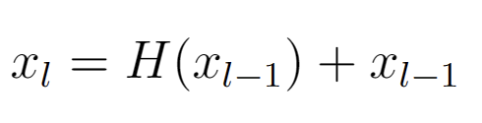
Layerwise Adaptation by using per-layer loss for automatic layer selection
Methodology: Estimate layer performance
Recall key component of Residual network is formulated as:
We can see a skip connection exists from layer l-1 to layer l
If we expand the formula:
There exist a skip connect that links any layer j (before layer l) to layer l
Loss function computed on the last layers output
Gradients directly backpropagated to the skip connections of each layer
Directly backpropagated -> Not modified
Each layer directly optimized for final loss
-> estimate performance from skip connections

Slide 40
Layerwise Adaptation by using per-layer loss for automatic layer selection
Methodology: Early stopping
Early stopping is a regularization technique
If model performance on dev degrades
-> Stops training of the whole network
We propose to early stop a layer if its performance degrades
Use a patience value U
Performance continue to degrade for U steps
Early stop layer
Unlike whole model early stopping, what happens to other layer

Slide 41
Layerwise Adaptation by using per-layer loss for automatic layer selection
Methodology: Early stopping
Unlike whole model early stopping, what happens to other layers after we early stop a specific layer A?
Other layers still need training
The layer early stopped should not be used as its performance has degraded
Resume training at the point where layer A has the best performance
Resume with layer A freezed
Applies to strategy A and B
In strategy C, the layer performance is always degrading
Adapt model on target domain, test layer performance in source domain
Use a tolerance value R
Early stop a layer if its performance has dropped more than R%

Slide 42
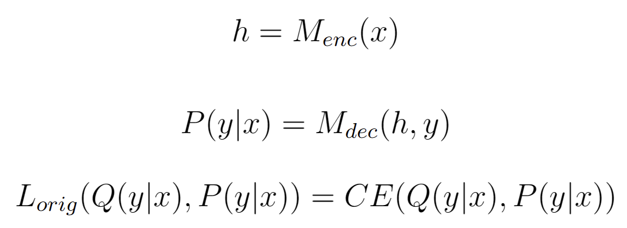
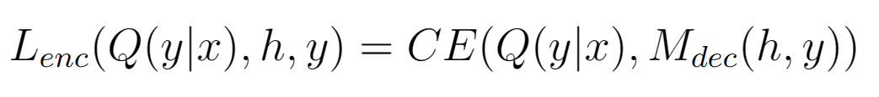
Layerwise Adaptation by using per-layer loss for automatic layer selection
Methodology: Evaluate encoder layers performance
Encoder layers skip connection are not directly connected to the final loss function
Encoder layer output passed to decoder
Decoder layer output passed to final loss function
Redefine the loss function to include the decoder

Slide 43
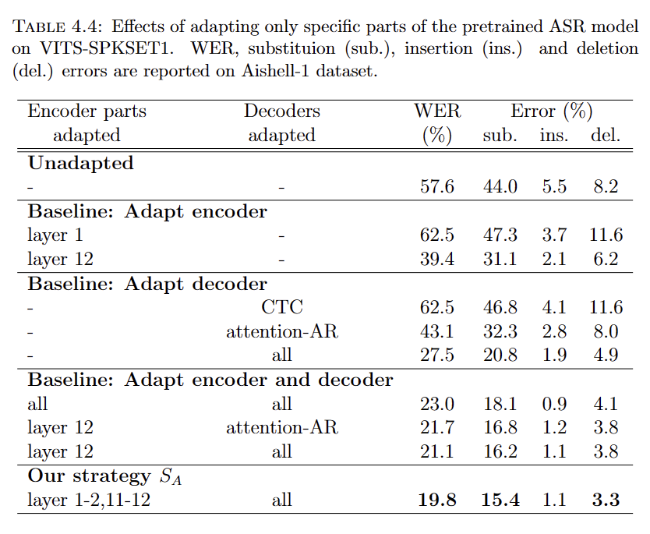
Layerwise Adaptation by using per-layer loss for automatic layer selection
Results: Strategy A
Conformer pretrained on Librispeech 100H
Adapted on TTS IMDA2
Baseline:
Full finetuning
Layerwise adaptation w/ heuristic + trail-and-error
Our approach: Strategy A
Freeze layer if their performance fluctuates
Adapt only layer 1-2, 11-12

Slide 44
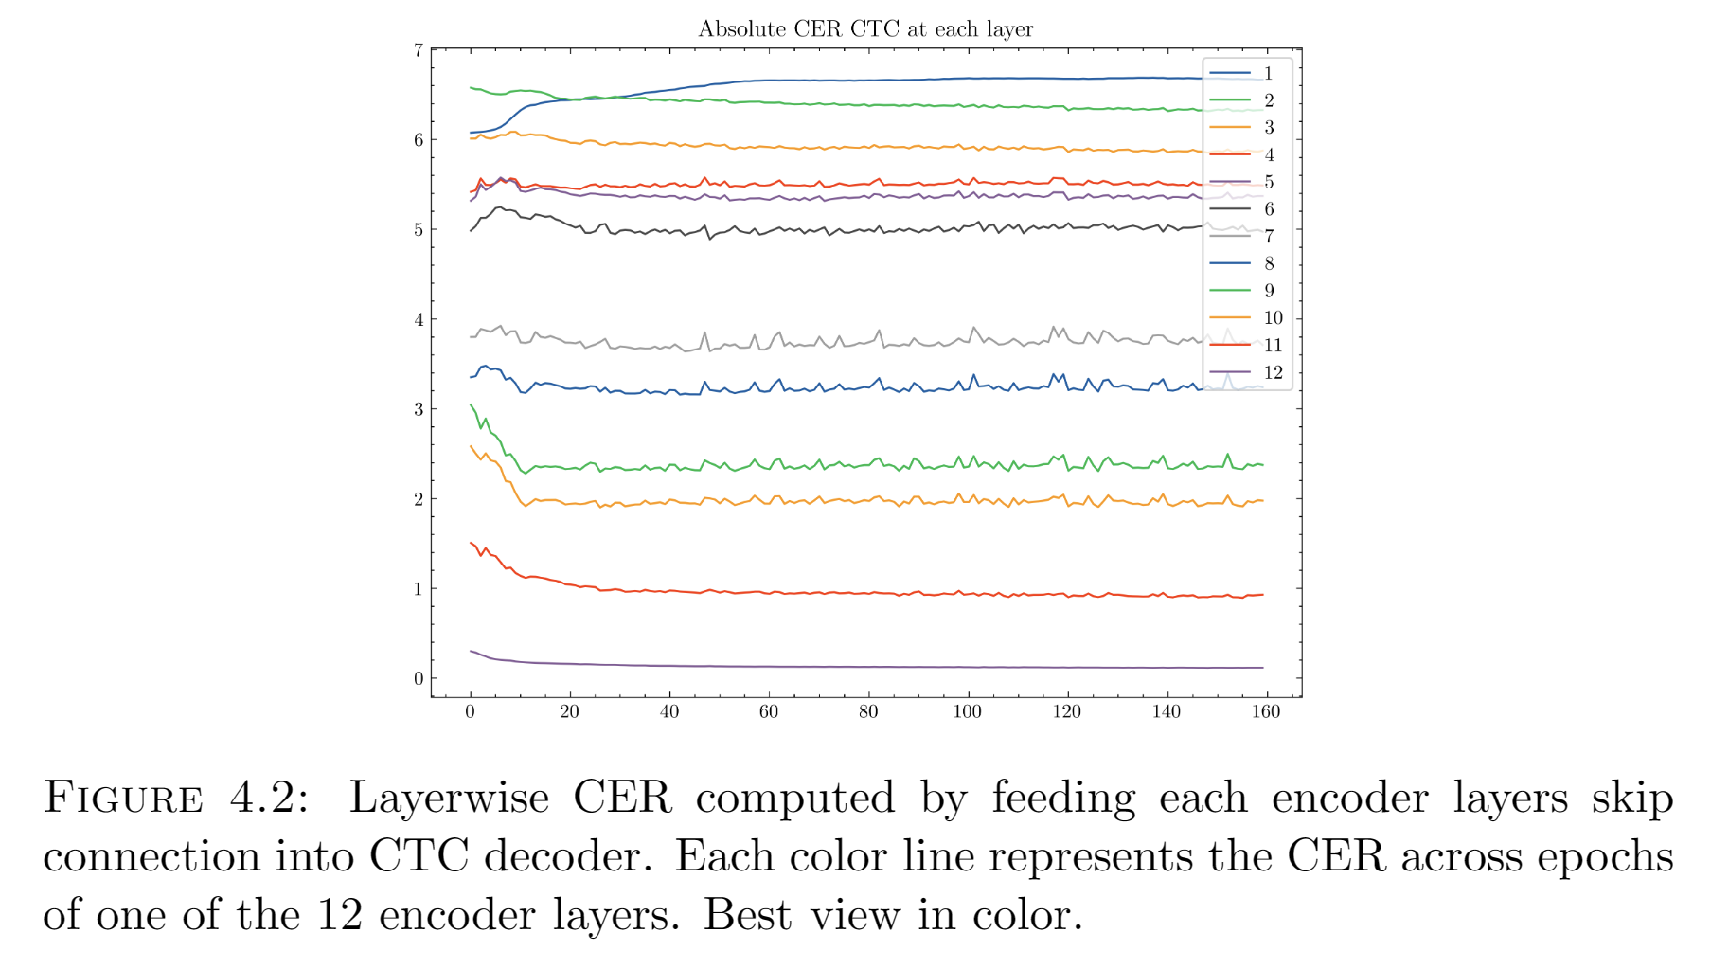
Layerwise Adaptation by using per-layer loss for automatic layer selection
Results: Strategy A
We train all layers of a model
Estimate the layer performance
Fluctuation observed for layer 3-10

Slide 45
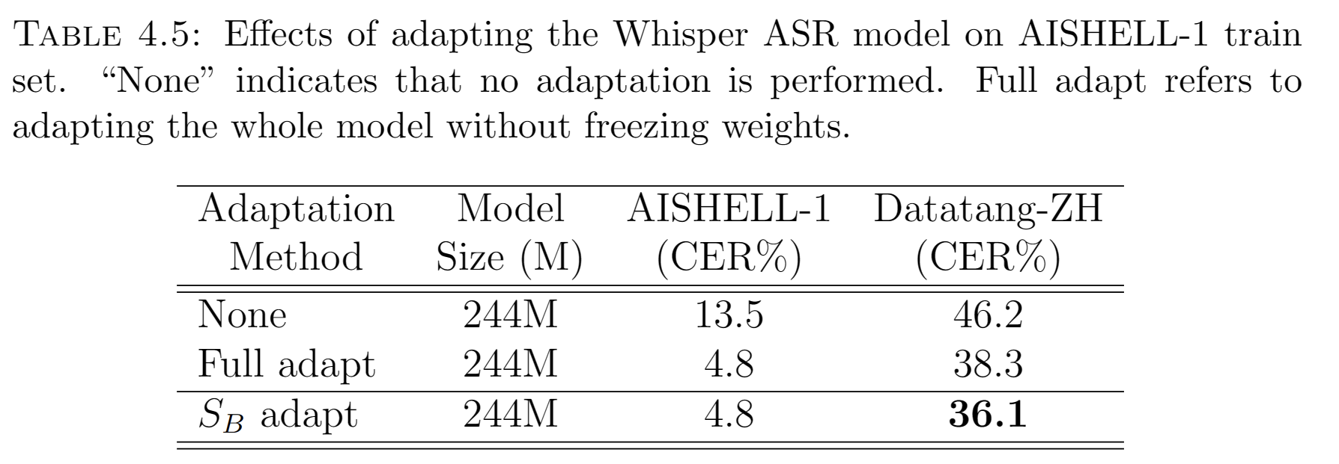
Layerwise Adaptation by using per-layer loss for automatic layer selection
Results: Strategy B
Pretrained model: Whisper-small
Adapted on AISHELL-1
Baseline:
Full finetuning
We neglect layerwise adaptation as it is too expensive
Our approach: Strategy B
Early stop layer if their performance degrades in target domain

Slide 46
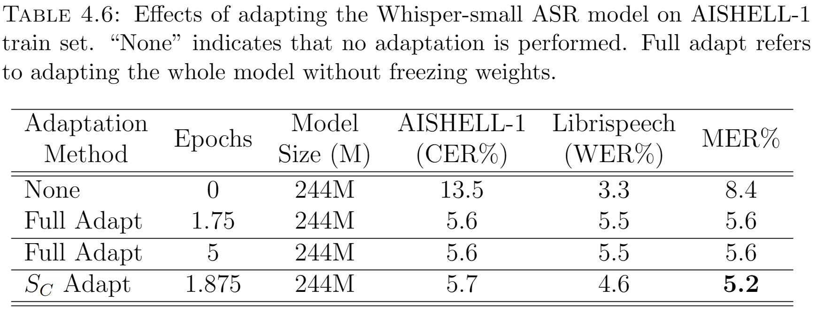
Layerwise Adaptation by using per-layer loss for automatic layer selection
Results: Strategy C
Pretrained model: Whisper-small
Adapted on AISHELL-1
Baseline:
Full finetuning
Our approach: Strategy B
Early stop layer if their performance degrades in source domain
Select only 5 audio samples from source domain as dev set

Slide 47
Conclusion
This thesis focused on
TTS synthesized data adpatation
Layerwise adaptation
Layerwise adaptation
Expensive search for optimal layers to adapt
We show an automatic way to select layers
Our method outperform baseline results
TTS synthesized data adaptation
TTS data diversity only improved by multi-speaker TTS previously
We explore improving the diversity with multiple TTS
Our method outperform baseline results

Slide 48
Future Work
Layerwise adaptation
Our work only applies to Residual Networks
Layer performance may be estimated by adding extra classification heads to each layer
TTS synthesized data adaptation
Our work only use 2 TTS systems to improve data diversity
Experiments of using more TTS systems and a study on each of their contribution to adaptation can be conducted

